Slide 1

Project Title – AIRBNB HOTEL BOOKING ANALYSYS PROJECT
ANUJ RAMESH SUKENKAR
INTERNSHIP_17546440516895be537820f

Slide 2

PROBLEM STATEMENT
AIRBNB HOTEL BOOKING ANALYSYS

Slide 3
Project Description
The hospitality industry has been transformed by online platforms like Airbnb, an American company founded in 2008 that offers diverse short-term lodging through a commission-based marketplace without owning properties. This research analyzes the New York City Airbnb dataset using data cleaning, exploratory analysis, and visualization to reveal key factors affecting listing availability, pricing, and customer satisfaction. The study provides valuable insights into Airbnb’s role in the city’s dynamic lodging market, benefiting stakeholders navigating the evolving short-term accommodation landscape.

Slide 4

WHO ARE THE END USERS?
The primary end users for the research analysis of the New York City Airbnb dataset described above are:
Hospitality Industry Stakeholders: Hotel operators, property managers, and real estate professionals utilize the data to analyze market dynamics and competitive strategies.
Urban Planners and Local Government: City officials and policymakers leverage these insights to understand the impact of short-term rentals on housing, tourism, and local communities.
Researchers and Analysts: Academics, data scientists, and industry analysts employ the dataset for trend analysis, forecasting, and further study on urban lodging patterns.
Travelers and Tourists: Individuals seeking short-term accommodations in New York City benefit by understanding availability, pricing, and customer satisfaction insights.
Airbnb Hosts and Property Owners: Those listing properties on Airbnb use the findings to optimize pricing, improve listing strategies, and enhance guest experiences.
These groups use the research to make informed decisions, improve operations, adapt to market trends, and foster a better accommodation environment in New York City.

Slide 5

Technology Used
Programming Languages: Python for data manipulation, analysis, and visualization.
Libraries/Tools: Pandas, NumPy, Matplotlib, Seaborn, or Plotly in Python;
Data Storage/Processing: CSV dataset management.
Data Visualization: in JUPYTER NOTEBOOK
Data Cleaning & Preparation: Techniques like data wrangling, missing data handling, and feature engineering primarily through scripting in Python.

Slide 6
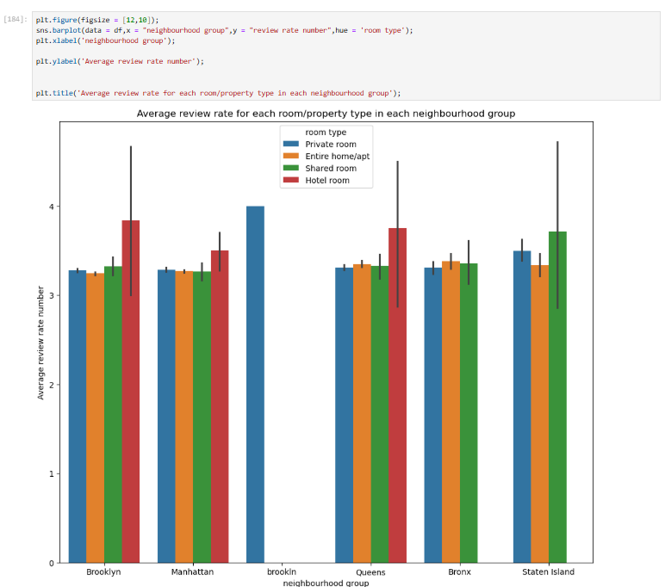
RESULTS1
[Add screen shots of your code or Chart(s) ]
Demo Link

Slide 7
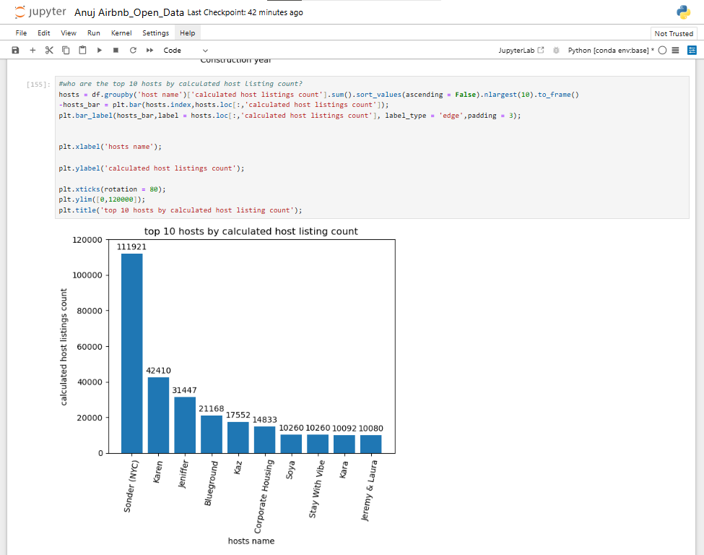
RESULTS2
[Add screen shots of your code or Chart(s) ]
Demo Link

Slide 8
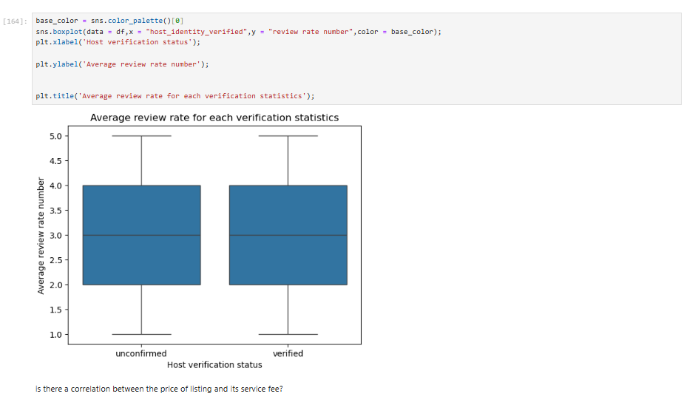
RESULTS3
[Add screen shots of your code or Chart(s) ]
Demo Link

Slide 9
GitHub repository
URL:-
https://github.com/anujsukenkar95/VOIS_AICTE_Oct2025_ANUJ_SUKENKAR.git
github repository NAME:-
VOIS_AICTE_Oct2025_ANUJ_SUKENKAR
Demo Link

Slide 10
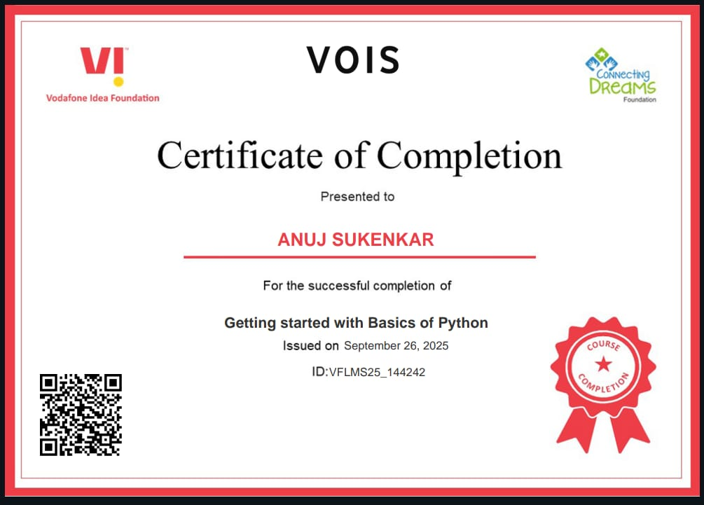
Getting started with Basics of Python Certificate
[Paste your Certificate Here]

Slide 11
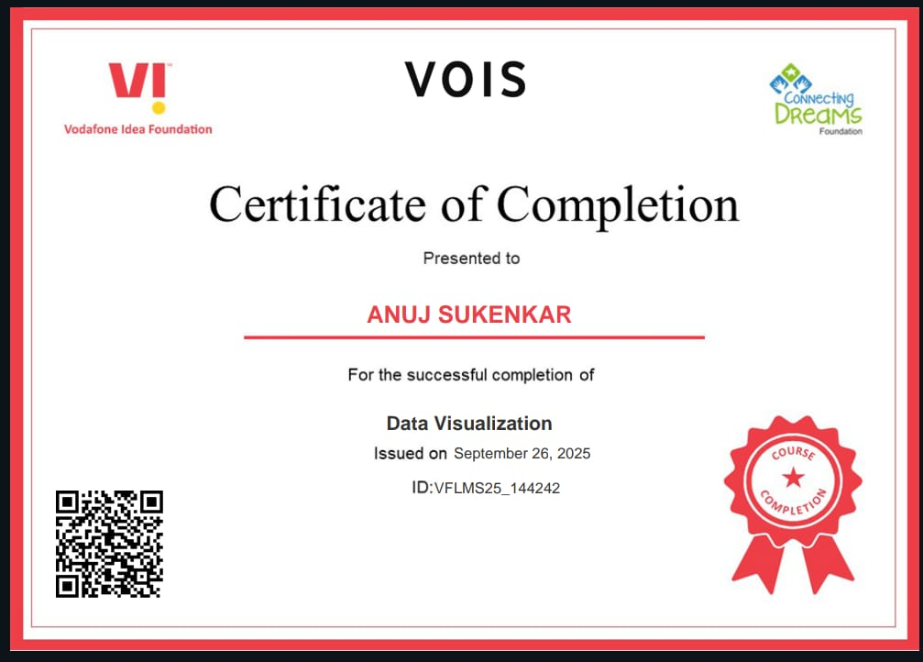
Data Visualization Certificate
[Paste your Certificate Here]

Slide 12
Thank you
.
.

